Slide 1

KULTUREHRE BUSINESS ANALYSIS
LEARNTERNSHIP
Understanding Career Aspirations of Gen Z
This presentation explores the career aspirations of Gen Z, a generation that is reshaping the workplace. By analyzing data, we gain insights into their priorities, values, and expectations, empowering organizations to attract and retain this valuable talent pool.
NB
NAVEEN BATHINI

Slide 2

Analyzing Gen Z Career Aspirations
Stage 1: Excel Dashboards
Initial data exploration and visualization are crucial for understanding Gen Z's career aspirations. Excel dashboards provide a flexible platform for organizing and analyzing data. They allow us to see trends, identify key factors, and form initial hypotheses.

Slide 3
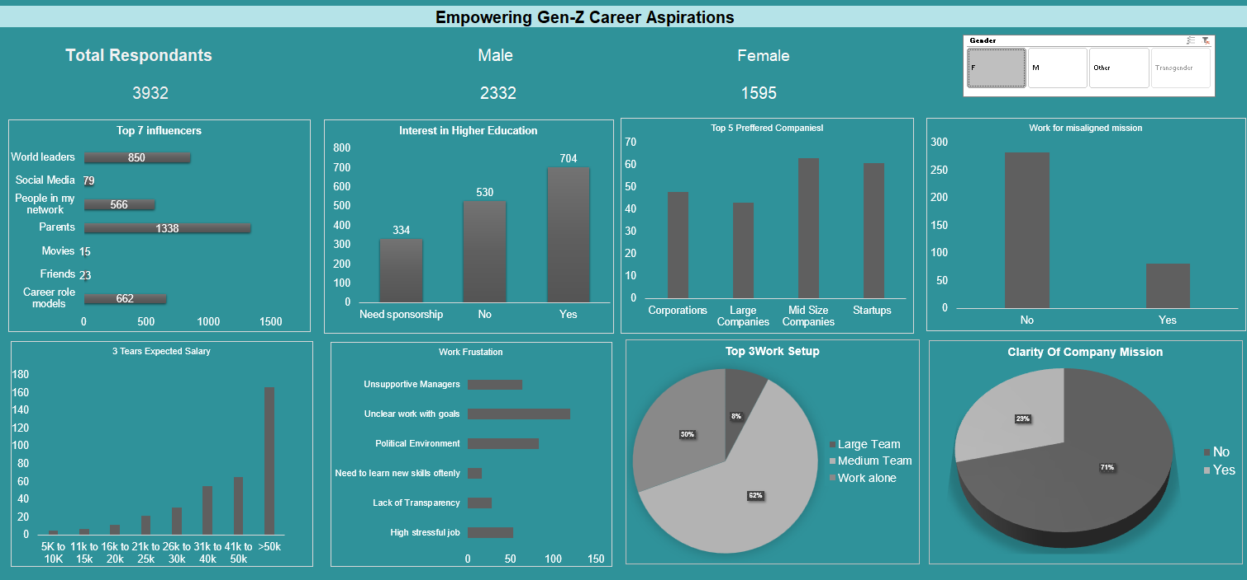

Slide 4
STAGE 2 :
PROBLEM STATEMENT

Slide 5
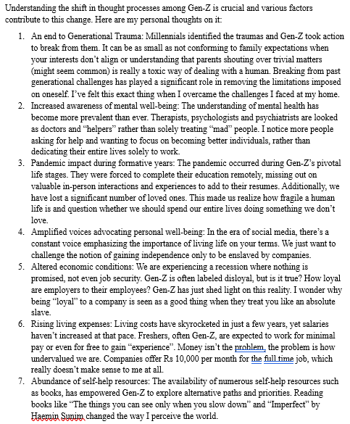
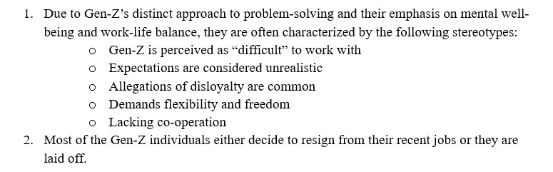
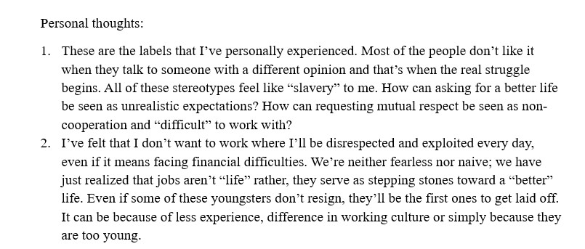
Personal thoughts on various factors contributing to this change in
Gen Z
What is happening?

Slide 6

Data Collection and Cleaning
Stage 3: Data Collection
Collecting relevant data is critical. This can be done through surveys, interviews, focus groups, and social media analysis. We need to gather information about Gen Z's career goals, desired work environments, and priorities.

Slide 7
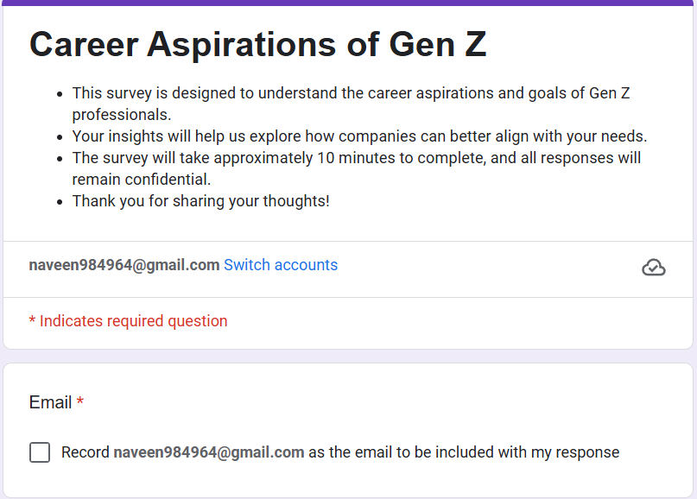
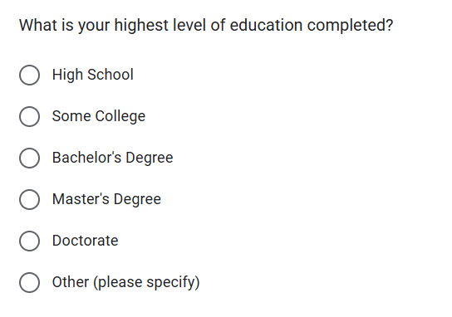
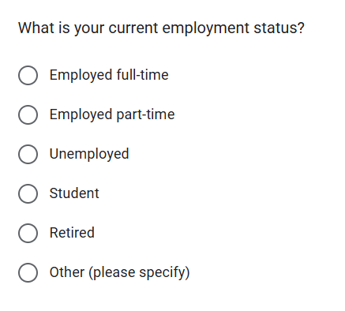
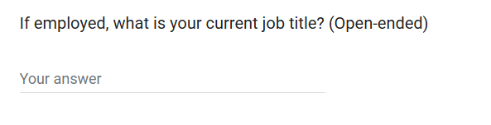

Slide 8
Stage 4:
Cleaning and Standardizing in
SQL
Once data is collected, it needs to be cleaned and standardized. SQL (Structured Query Language) is a powerful tool for managing and manipulating data. It allows us to clean inconsistencies, format data, and prepare it for analysis.

Slide 9

1. What industries are Gen-Z most interested in pursuing careers in?
2. What are the top factors influencing Gen-Z’s career choices?
3. What is the desired work environment for Gen-Z? (e.g., remote, hybrid, in-office)
4. How do financial goals, such as salary and benefits, impact career aspirations among Gen-Z?
5. What role do personal values and social impact play in career choices for Gen-Z?

Slide 10
SELECT industry, AVG(interest_level) AS average_interest
FROM gen_z_careers
GROUP BY industry
ORDER BY average_interest DESC
LIMIT 5;
SELECT goal_type, AVG(impact_level) AS average_impact
FROM financial_goals
GROUP BY goal_type
ORDER BY average_impact DESC;
SELECT industry, AVG(interest_level) AS average_interest
FROM gen_z_careers
GROUP BY industry
ORDER BY average_interest DESC
LIMIT 5;
SELECT value, AVG(importance_level) AS average_importance
FROM personal_values
GROUP BY values
ORDER BY average_importance DESC
LIMIT 5;
SELECT environment_type, AVG(preference_level) AS average_preference
FROM work_environment
GROUP BY environment_type
ORDER BY average_preference DESC
LIMIT 3;

Slide 11
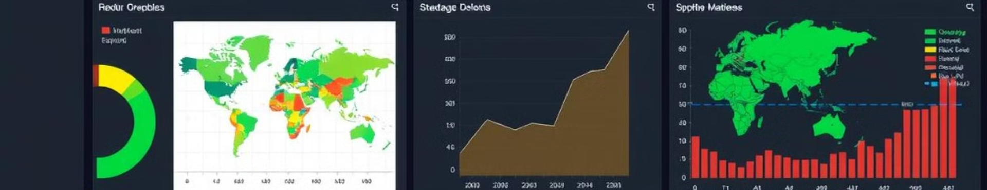


General Power BI Dashboards
Stage 6: General Power BI Dashboards
Stage 7: Focus Area Driven Power BI Dashboard
Power BI is a data visualization tool that allows us to create interactive dashboards. We can use Power BI to present key findings in a visually appealing and easily understandable format.
We can create a focus area driven dashboard that highlights specific insights about Gen Z's career aspirations. This can be tailored to specific stakeholders and tailored for their specific needs.

Slide 12
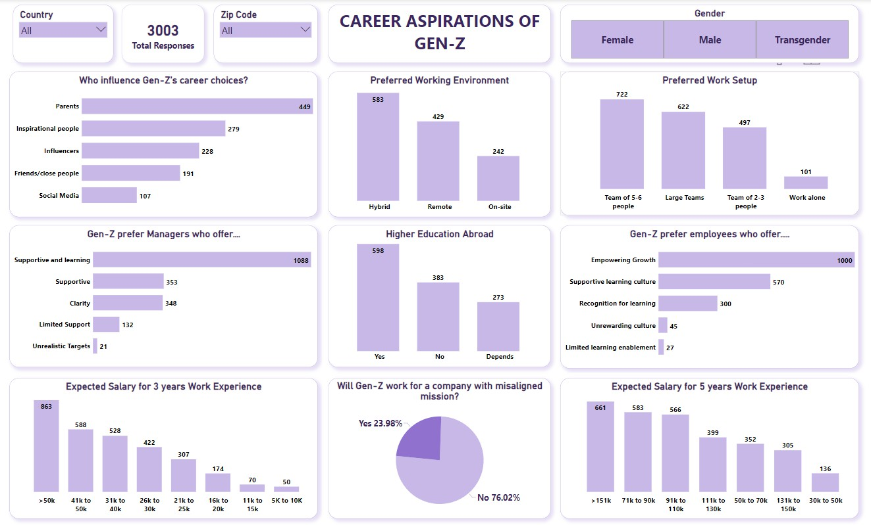

Slide 13
STAGE 7:
FOCUS AREADRIVEN
POWERBI DASHBOARD

Slide 14
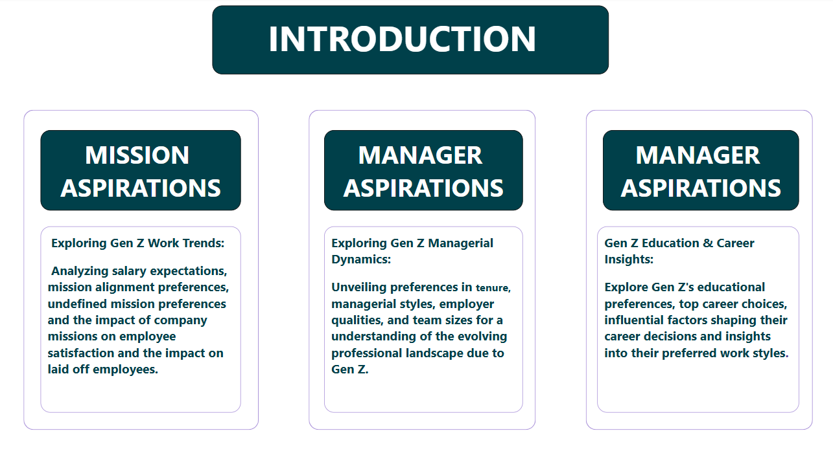

Slide 15
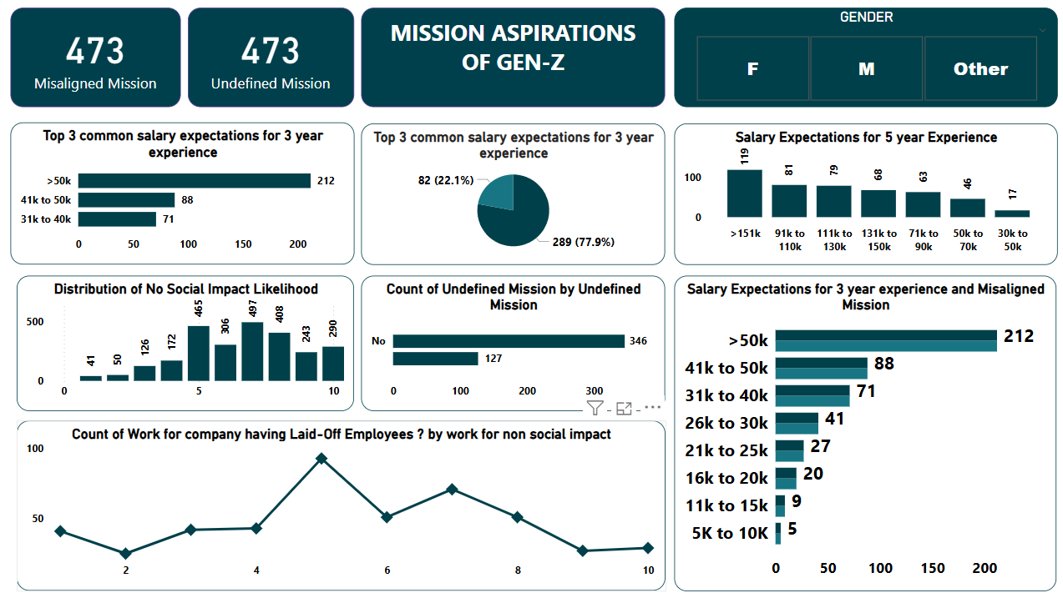

Slide 16
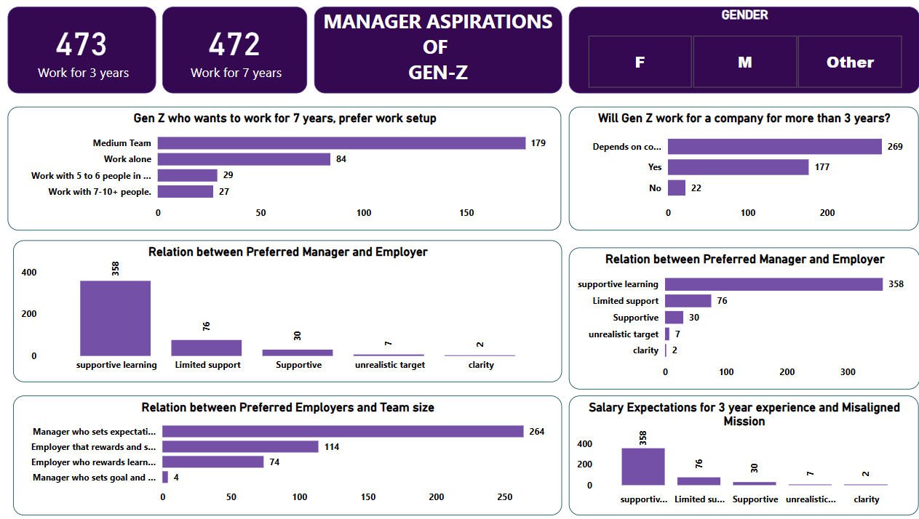

Slide 17
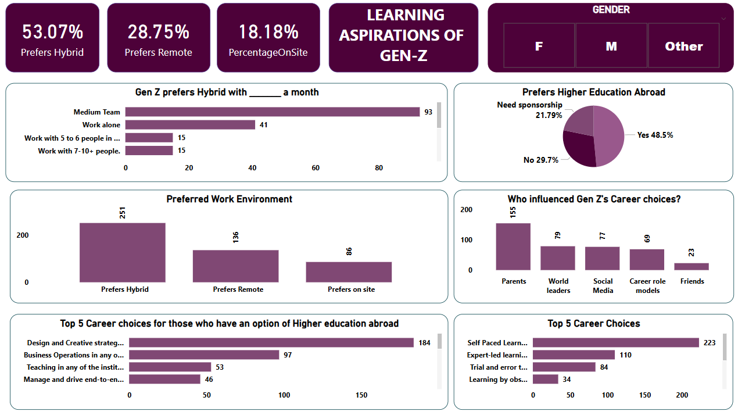

Slide 18
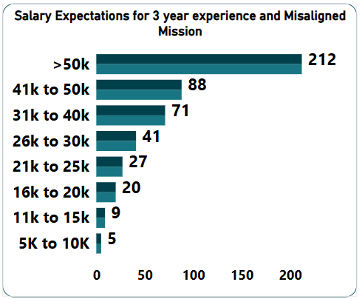
INSIGHTS:
Gen Z wants to work for managers who offer:
Supportive and Learning: 56%
Supportive: 18%
Clarity: 18%
Limited Support: 7%
Unrealistic Targets: 1%
PROBLEM
Poor Managers or Leadership
RECOMMENDATIONS
❏ Invest in leadership development programs
❏ Implement a feedback system
❏ Schedule regular meetings with the managers and teams to ensure open communication

Slide 19
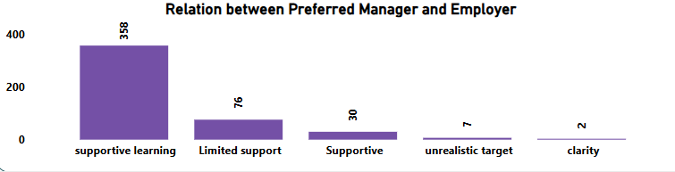
Insights:
Prevalence of Supportive Learning
Limited Support ImpactSupportive .
Problems Identified:
Lack of Support Variety
Neglect of Clarity and Realistic Targets:
Recommendations:
Enhance Support Mechanisms
Focus on Clarity in Communication
Set Realistic Targets

Slide 20
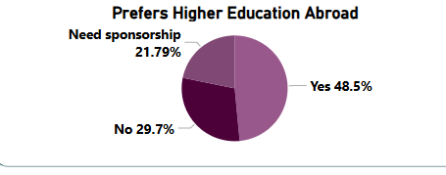
Insights:
Preference for Higher Education Abroad:
Need for Financial Support:
No Preference or Feasibility Concerns:
Problems:
Financial Barriers
Diverse Attitudes
Recommendations:
Enhance Sponsorship Programs
Address Awareness and Perception
Explore Local Alternatives

Slide 21




Key Takeaways
Adaptability
Gen Z prioritizes adaptability and continuous learning. They seek roles that offer opportunities for growth and development.
Meaningful Work
Gen Z values purpose and social impact. They are more likely to choose jobs that align with their values and make a positive contribution to society.
Work-Life Balance
Work-life balance is critical for Gen Z. They seek employers who offer flexible work arrangements, competitive benefits, and support for personal well-being.

Slide 22

Leveraging Insights for Success
45%
Retention
By understanding Gen Z's career aspirations, companies can improve employee retention. They can create work environments that align with Gen Z's priorities and support their professional growth.
$1.5M
Recruitment
Data insights allow companies to target recruitment efforts to attract Gen Z talent. They can develop marketing campaigns that highlight the values and opportunities that resonate with this generation.

Slide 23

Next Steps
The next steps involve further research and exploration. We can conduct in-depth interviews with Gen Z professionals to gain a deeper understanding of their experiences and aspirations. This valuable data can then be used to improve recruiting and retention strategies, creating a more engaging and fulfilling workplace for all.

Slide 24

THANK YOU!

